Slide 1

A PRESENTATION ON THE ECONOMIC IMPACT OF COVID 19 IN KUMASI
KUMASI METROPOLITAN ASSEMBLY

Slide 2
ORDER OF PRESENTATION
The City of Kumasi
Introduction
Core challenges of the municipal
Measures by the municipal to address them
Vulnerable groups
Development and service related priorities after the pandemic.
Lesson learned

Slide 3

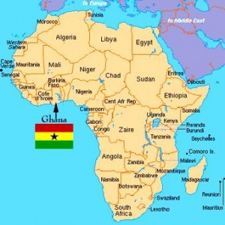
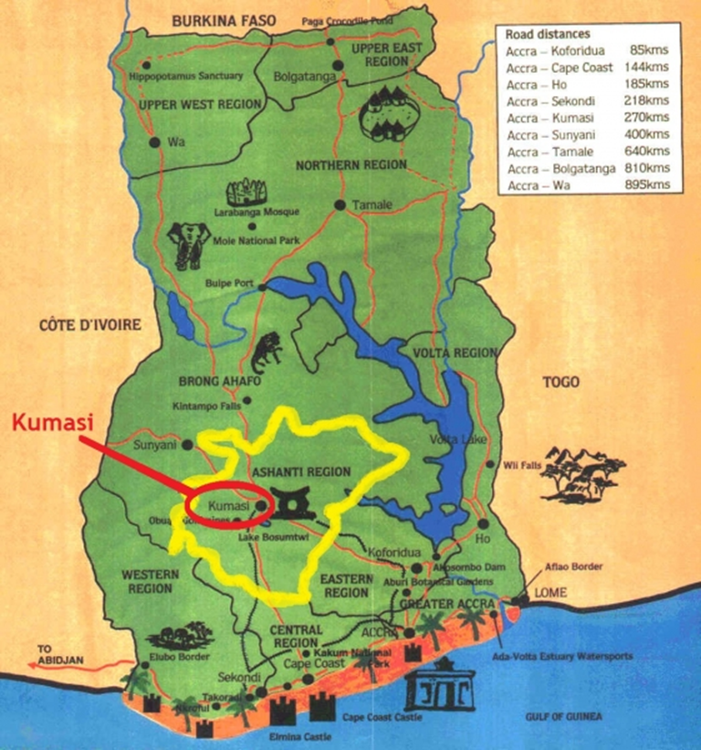
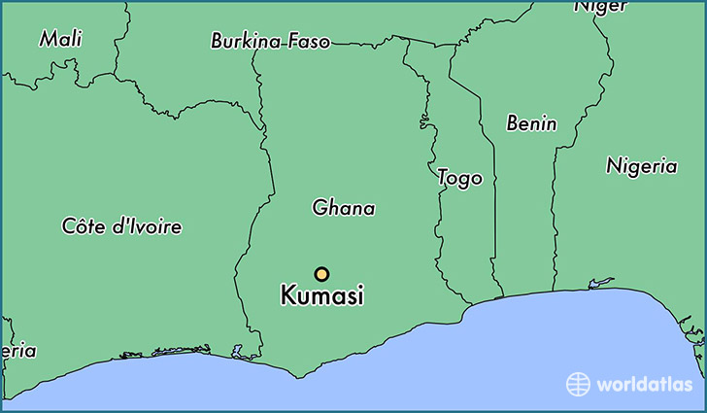
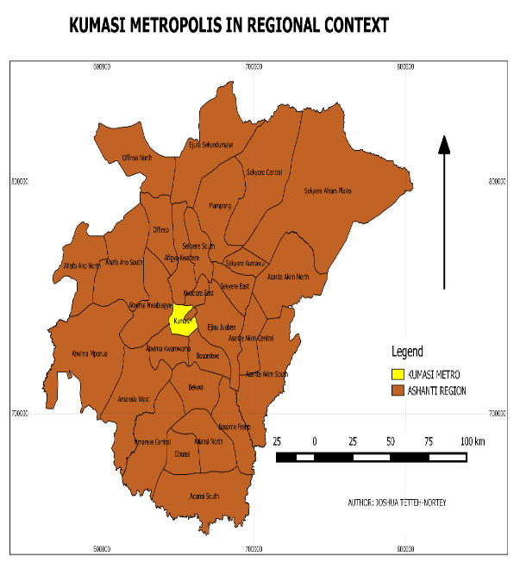
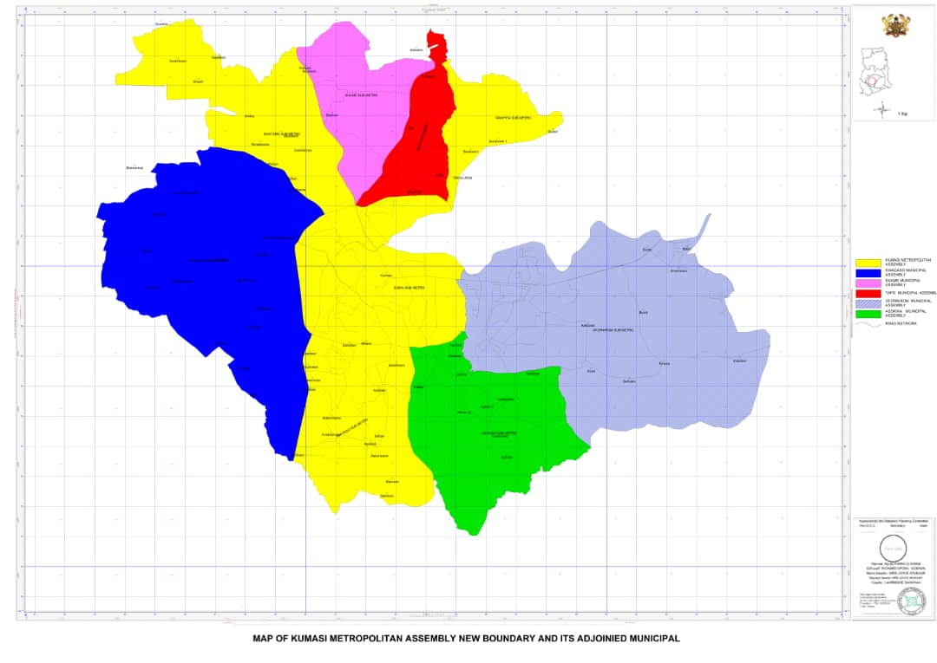
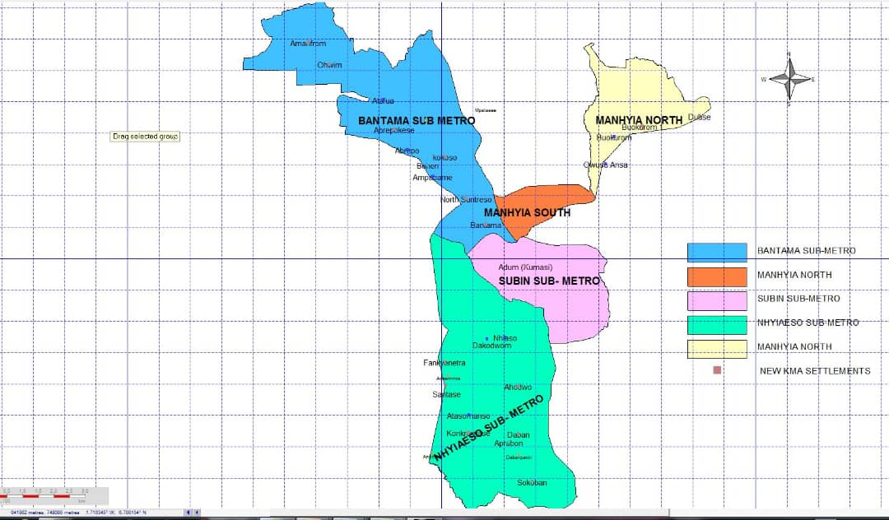
1.Location of the city
Total land area: 238km²
Total Land area: 78.28km²
KMA
Notes:
etc.

Slide 4

2. Vision, Mission and Core values
Vision
‘ To become a Safe smart City and Investment destination for both local and international investors ’
Mission
‘ The Kumasi Metropolitan Assembly is committed to improving the quality of life of the people in the metropolis through the provision of essential service and creation of an enabling environment to ensure the total and sustainable development of the city’.
Core Values
To provide timely, open and accountable services to our clients, interest groups, companies, individuals and all other stakeholders.
KUMASI METROPOLITAN ASSEMBLY ©2019

Slide 5



3. Demography and density
Population
Ashanti Region : 5,661,728
Greater KMA : 2,361,898 (42%)
Core KMA
Day population : 1,500,000
Night population: 866,268
47.8%
52.2 %
Population Density
Core KMA: 11,066/ km²
Greater KMA: 9,915/km²
Notes:
The metropolis shares boundaries with Afigya Kwabre District to the north, Atwima Kwanwoma District to the south, Asokore Mampong Municipal and Oforikrom Municipal to the east and Kwadaso Municipal to the west. It also shares boundaries with Atwima Nwabiagya Municipal to the North west, Suame Municipal to the north east and Asokwa Municipal Assembly to the south east.
This shows the greater Kumasi Map. However, The shaded portions (violet) shows the map of the new KMA. Adjoining Districts include Atwima Kwawoma, Asokwa, Oforikrom, Kwadaso, Asokore Mampong and Suame.
Again this shows the strategic location of the Metropolis making it possible to work together with adjoining districts in the development process
People moving from the South and North of the Country pass through the City of Kumasi
Making its location strategic, however this also comes with its challenges like poor sanitation, congestion on available services etc.

Slide 6
Economic Impacts of COVID-19
Reduction in revenue collection (projected annual loss of $2million (30% Revenue Loss).
Increase in expenditure to fight the pandemic/ Resources earmarked for other development projects/programmes channeled to fight covid – 19
An outstanding expenditure of about $ 300,000 to be paid on COVID-19 related activities.

Slide 7
Economic Impacts of COVID-19
The City is not able to meet its basic financial obligations including payment of locally recruited staff
Reduction in Municipal investments
Reduction in productivity of workers
40% reduction of income of transport operators
High cost of transport operations
Reduction in trade activities especially from the neighbouring Countries ( Burkina, Togo, Nigeria etc)

Slide 8
Measures Undertaken to Help Fight The Pandemic
To increase the capacity of local health system, by
  Increasing collaboration with GHS to secure PPEs
  Securing more facilities to serve as isolation center.
Community awareness and mobilization;
  Embarking on mass intensive community awareness through radio stations, information centers and ISD
  Organizing stigmatization reduction campaigns.

Slide 9
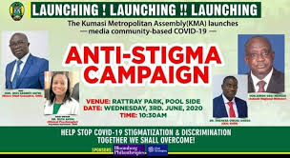
Measures Undertaken to Help Fight The Pandemic
Social protection measure;
  A collaboration with donors/organization such as VNG, CRC and the Latter Day Church to supply and distribute items to vulnerable groups.
Enforcement of the public order and regulations by government ;
  Closure and lockdown of schools, practices of social distancing, ban on public gathering such as religious and recreational activates.
Provision of Essential services by introducing color coding
  Collaborated with the Ghana Police Service and Military to enforce laws

Slide 10
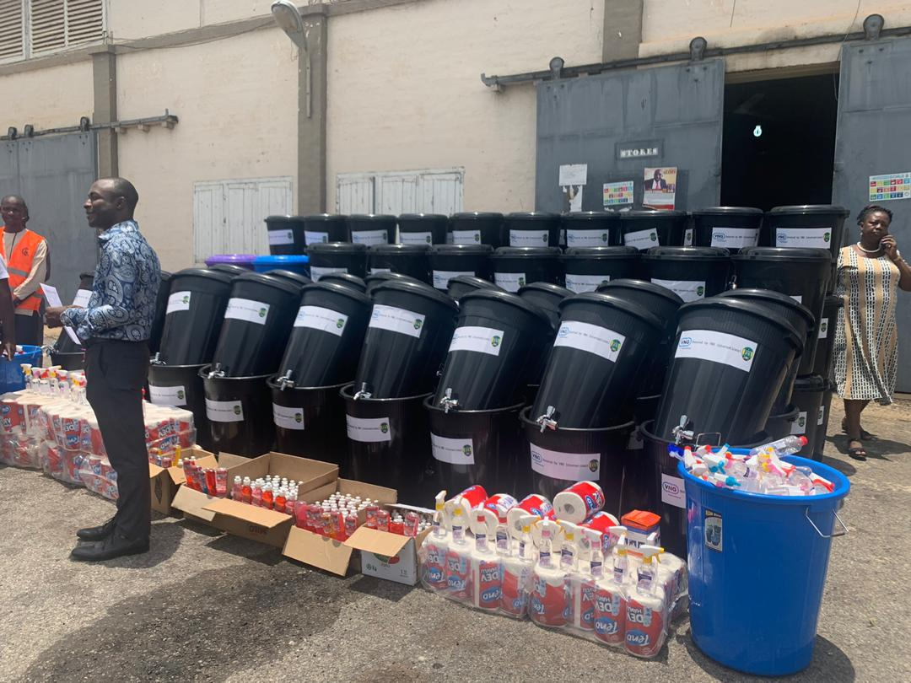
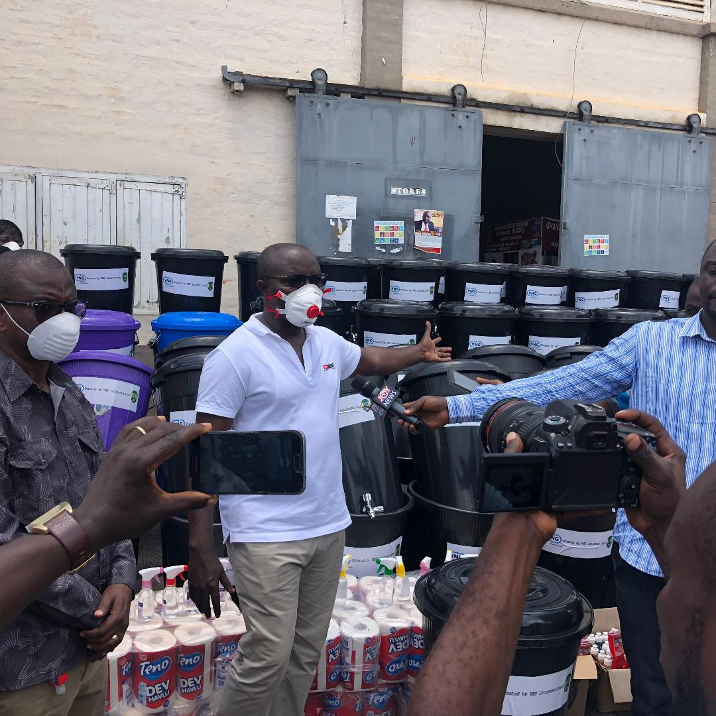
Intervention to Help The Vulnerable Groups
V
Vulnerable groups( Widows, Disabled, street children, head potters, etc) identified were supported with:
  Relief Items ( Rice, Oil, Soaps, Mackerel, etc)
  PPEs (Nose Masks, Gloves, Hand Sanitizers ,
  Sensitization Campaigns on radio, information centres and communities
  Stimulus packages for SSEs

Slide 11
Development and Service Related Priorities After The Pandemic
The City has resolved to focus on more economic related capital investment that will increase revenue generation such as;
  Construction of multistory car parks
  Markets
  Recycling of waste
  Convention Centres and Museums

Slide 12
Lessons Learnt
The City will from now save 5% of its annual IGF in an escrow account to cater for future emergencies like covid 19
The Assembly will undertake economic related capital investment to increase revenue generate.
Introduce IT and reduce human contacts in revenue collection.

Slide 13



