Slide 1
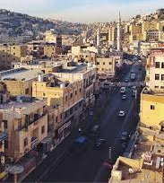
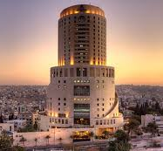
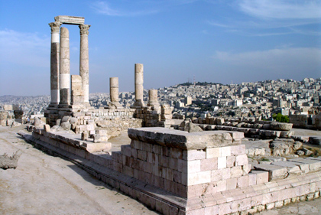
Amman
Sustainable Urbanization and Resource Efficiency

Slide 2
Amman
The capital and largest city of Jordan
Population of 4.2 million
Originally, the city had been built on seven hills
Temperatures are usually near or below 17 °C, with heat waves during summer, snow fall durin winter.
Area of Amman = 800 km2
Amman is governed by a 41-member city council elected in four-year term direct elections.
Cultural and heritage city with vibrant street life.

Slide 3
waste in Amman in numbers
Number of waste bin containers= 28,000
Number of Truck, loaders= 280
Avg. monthly waste collection = 69,000Ton/ month
Avg monthly distance travelled by truck and loaders= 680,000 km/ month
Avg monthly fuel consumptions by distanced travelled = 450,000 L/ month
Avg monthly number of trips for all truck and loaders = 28,000 trip/ month

Slide 4
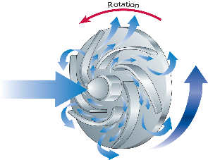
Sustainable plan for the city of Amman using the Urban Sustainable Framework ( USF)
The Accelerator
Smart plan
Health Resilience plan
Sustainable Plan
City BIG- Data
National GIS
City Lab

Slide 5
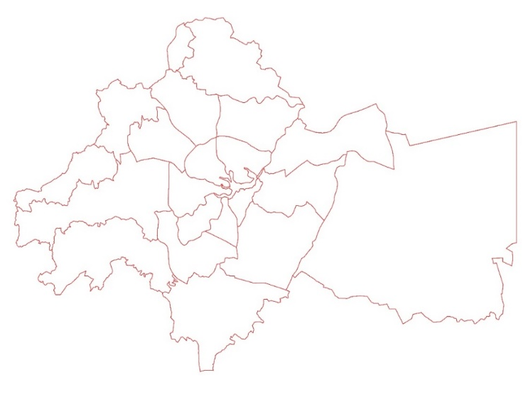
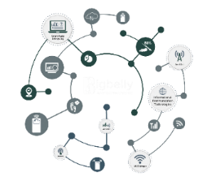
Sustainability map for district level
Sustainability criteria
97
indicators
Local district

Slide 6
Sustainability plan for Solid waste management for district level
Project Output
Output One: Data collection of waste generated by each district.
Output two : Development of a Sustainability Planning for municipal, bio-medical and hazardous Solid waste management along with Financing Strategy for implementing and financing the intervention plans.
Key words in management : identification of waste at each district- collection and storage – transportation- treatment – energy recovery- disposal
Local district

Slide 7
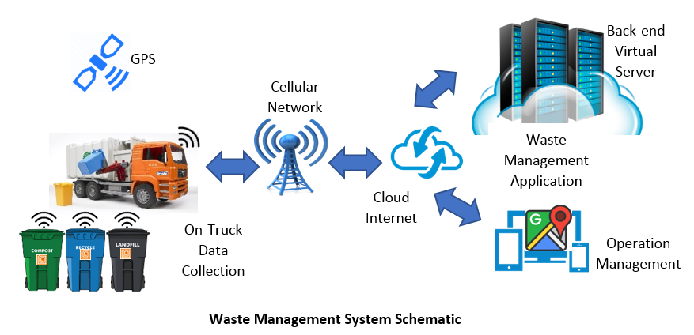
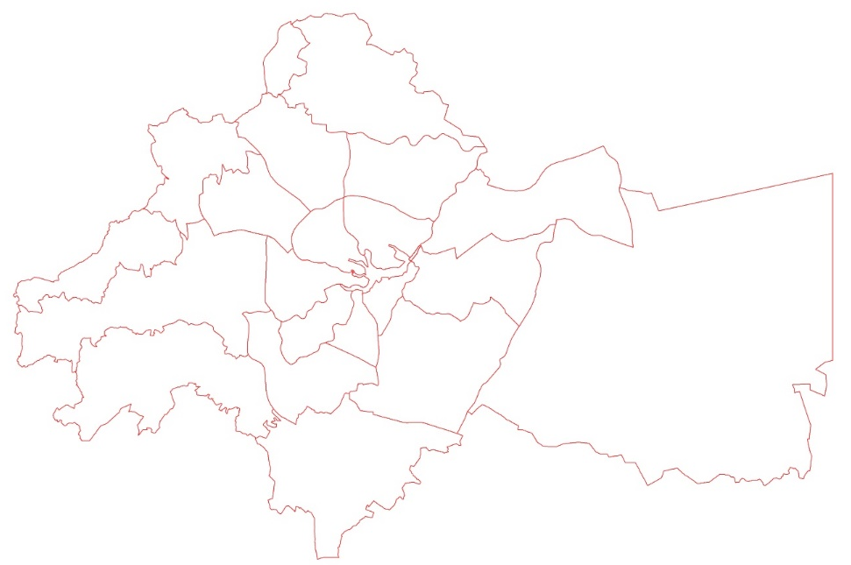
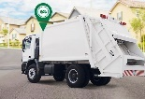
Amman’s Sustainable Plan / smart knowledge base solid waste waste
ohud
quaismeh
90 | اresidential
60 | COMMERCIAL
10 | OFFICE
150 | INDUSTRIAL
10 | CRAFTMANSHIP
20 | STREES
5 | PARKS
300 | اresidential
350 | COMMERCIAL
100 | OFFICE
120 | INDUSTRIAL
50 | CRAFTMANSHIP
30 | STREES
20 | PARKS
1200
600
.900
300
800
920
Wadi a sier
Al naser
100 | اresidential
100 | COMMERCIAL
60 | OFFICE
80 | INDUSTRIAL
30 | CRAFTMANSHIP
20 | STREES
20 | PARKS
200 | اresidential
300 | COMMERCIAL
120 | OFFICE
120 | INDUSTRIAL
40 | CRAFTMANSHIP
37 | STREES
23 | PARKS
basman
Wadi alsier
zahran
naser
Qwiesmeh
zahran
basman
ohod
300 | اresidential
160 | COMMERCIAL
120 | OFFICE
50 | INDUSTRIAL
20 | CRAFTMANSHIP
30 | STREES
20 | PARKS
130 | اresidential
80 | COMMERCIAL
60 | OFFICE
30 | INDUSTRIAL
10 | CRAFTMANSHIP
20 | STREES
20 | PARKS
0.350 -145
145-826
826-1696

Slide 8
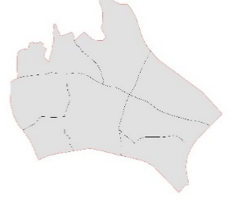
Amman’s Sustainable Plan
Flash flood
Waste consumption
Water consumption
Energy consumption
district
10000 M2
1000 M/W / MONTH
500 M/W / MONTH
48492م2
وادي السير
50000 M2
3000 M3/ MONTH
600 M/W / MONTH
72951م2
تلاع العلي
138039م2
40000 M2
800 M/W / MONTH
2000 M2/ MONTH
القويسمة
20000 M2
3000 M2 / MONTH
400 M/W / MONTH
6800م2
النصر

Slide 9
Thank You
Notes:
9

