Slide 1
Sanitation and Solid Waste Management in Al Taibah Al Jadidah Municipality By: Mohamad.O. Alawneh

Slide 2
Overview Al Taibah Distrct is located west of Irbid governarate with population of around 56, 000 resident (JDoS, 2019) destriputed in 5 sub-administrative areas 1- Al Taibah 2- Samma 3- Mandah 4- Dair Al Sinah 5- Mikhraba and Zabda. The Distract have a total area of 63.5 km²

Slide 3
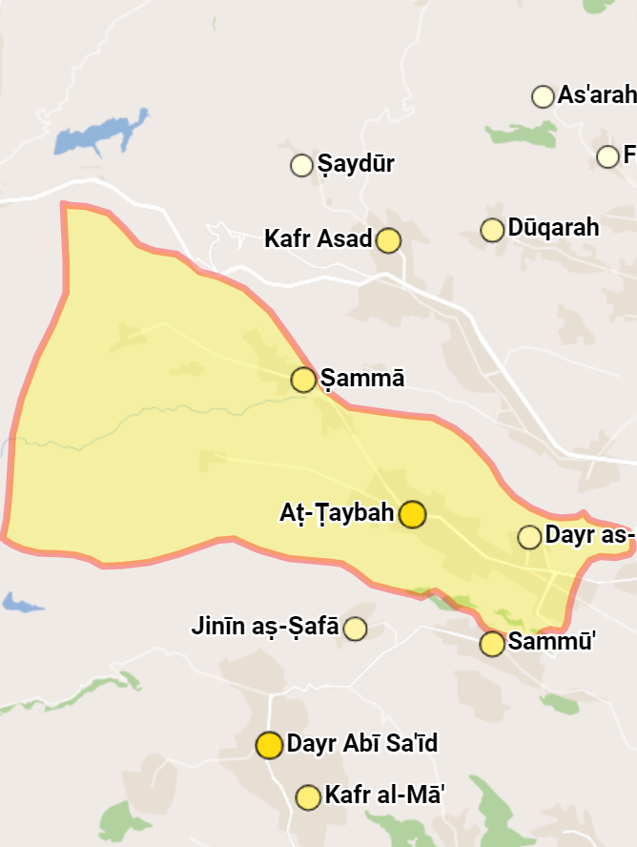

Slide 4
The population and refugees influx to the district The population growth and immigration flux to the district as many parts of the northern parts of the country in years 2012-2015 have caused population high and rapid increase and the multi-dimensional pressures on the socio-economics and livelihoods of the population including the basic services like water, sanitation and household solid waste management. Population density of 881.9/km² [2019] and grouth rate of + 5.24%/year.

Slide 6
Currint setuation in the district Water Supplies in the district: Water supplies in the destrict is operated and managed by Al Yarmouk Water company, the percintige of housolds connected to the water network is around 96% (MWI 2018)

Slide 7
Sanitation, sewage and wastewater.
The district is not served with sewage or wastewater collection and treatment system, the population of the district is using the classical traditional septic tanks for storing the wastewater.
The traditional septic tanks are unpaved and unprotected and basically they are a natural or artificial cavities excavated in the ground.

Slide 8
Challenges in wastewater and sanitation
The Municipality is responsible for supervision and monitoring the situation of the of septic tanks, it owns two non-operational wastewater tanks, the population of the distract is fully dependent on the privet sector wastewater tanks which is very problematic before and during the pandemic.
Before the pandemic the illegal discharging of this tanks in the natural drainages, water streams and uninhabited areas was a common case with no verification method that all the wastewater ends in the treatment plants except for newly tracking system by the MoENV.

Slide 9
That was causing a huge environmental problems and affecting the nature and the health of the population.
During the pandemic and within the total lockdown the distract areas witnessed many cases of overflowed septic tanks and the privet sector were incapable of providing the service to the householders or the businesses in the district.

Slide 11
Solid waste management.
Solid waste management process in the municipality is based on three major operations
1- Collection
2- recycling
3- disposal
The estimated amount of the solid waste collected on daily base from the five sup-areas of the distract is around 120 tone( according to the Municipality and not verified from independent source) with around 10%- 15% or 12-15 tone of solid recyclable waste ( paper, metals )

Slide 12
The collection is operated with around 125 men ( official numbers )
this waste transported to a recycling plant which was built in 2018 , funded by GIZ with cooperation with Canada Aid and UNDP.
The station also contains a sorting facility and transformation station for waste where the organic and non recyclable waste compressed and sent to Al Ikadir landfill which is the biggest landfill in north of Jordan.

Slide 15
Challenges in Solid Waste Management
Al Taibah Al Jadida Municipality is facing many challenges before and during COVID-19 pandemic .
The latest's and pandemic related challenges that faces the municipality is the high risks imposed on the employees spicily in waste collection which result in high exposure to pathogenic factors.
The medical waste including gloves, masks and other related waste impose extreme risk on the public and workers health and needs some precautionary measures that were not implemented in the majority of the workers due to operational and financial restrictions.
Other challenges faced the municipality during the total lockdown was the accumulation of the solid waste due to postponing waste collection operations.

Slide 16
Other major challenge is the financial burden due to the payroll which is consuming up to 70 % out of the annual budget leaving no space for any developments project by the municipality resources.
The operational costs is consuming the rest of the budget 30% including fuel, maintenance..etc.. and debt. services is quite high in most of the municipalities and needs more studies to address the causes and reasons of it.
Other operational challenges faced by the municipality is the delay in starting operations of the transferee station, which imposed additional cost and efforts to send the organic waste to other stations as the landfill of the municipality was closed.

Slide 17
One of the majors challenges for the municipality and the public sector in general is the ghostly employment and the ineffective employees.
we are witnessing the phenomena of ghostly employment were the employees receives there pay chicks every month without even attending the HQ or preforming any type of work.
The case is very sensitive to the municipality and the real number of active and non active workforce is quite unknown , the phenomena needs more studies to address and solve this issue within the municipal sector in Jordan

