Slide 1
Greater Amman Municipality preventive measures to tackle the COVID-19
Dr. Mervat Almheirat
Deputy city manager of health and agriculture
Greater Amman Municipality

Slide 2
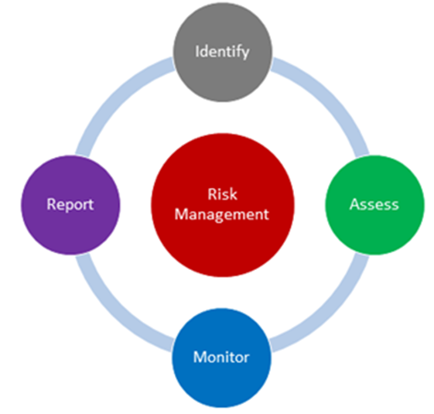
Preparation and start stage: The Mayor of GAM announced new decisions to confront Corona
Stages of emergency management
Stages of Risk communication within GAM
Sustainability stage
(September 2020-September2022)
Recovery stage
(June – August 2020)
Notes:
Start stage: GAM has taken preventive measures to tackle the COVID-19
Approved sterilizers for surfaces and floors in the departments
Distributions of PPE “masks and gloves “to workers
Installation of hand sanitizers in all GAM buildings
Recovery stage: Gradual expansion of services.
Focusing efforts on marginalized and disadvantaged groups
Promote sectoral coordination.
Monitor and evaluate results and prepare reports to ensure improvement
Sustainability stage: Modify strategic frameworks and plans to incorporate contingency plans
Developing and strengthening emergency preparedness operations based on the evaluation of the previous stages
Establishing sustainable action plans for the emergency

Slide 4
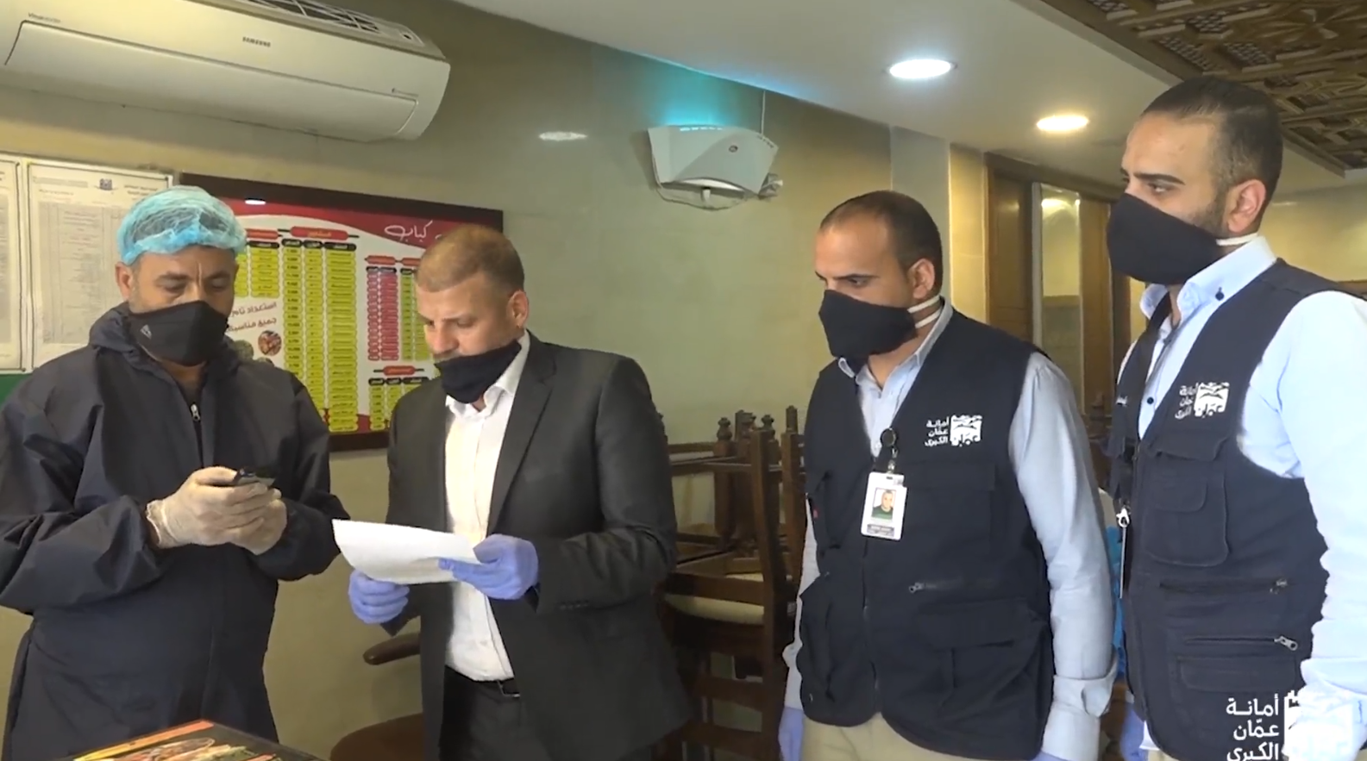
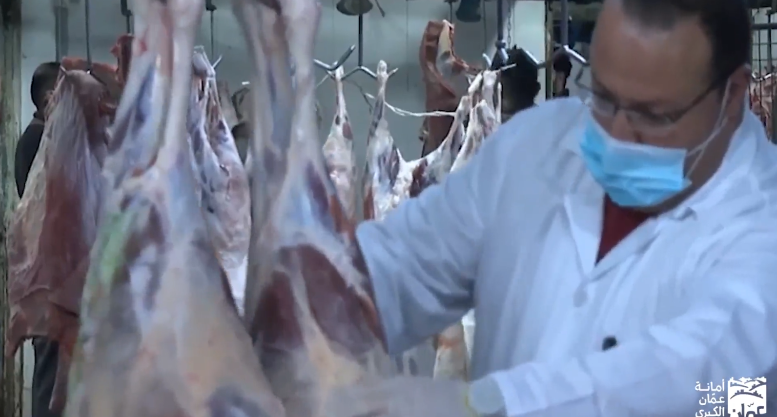
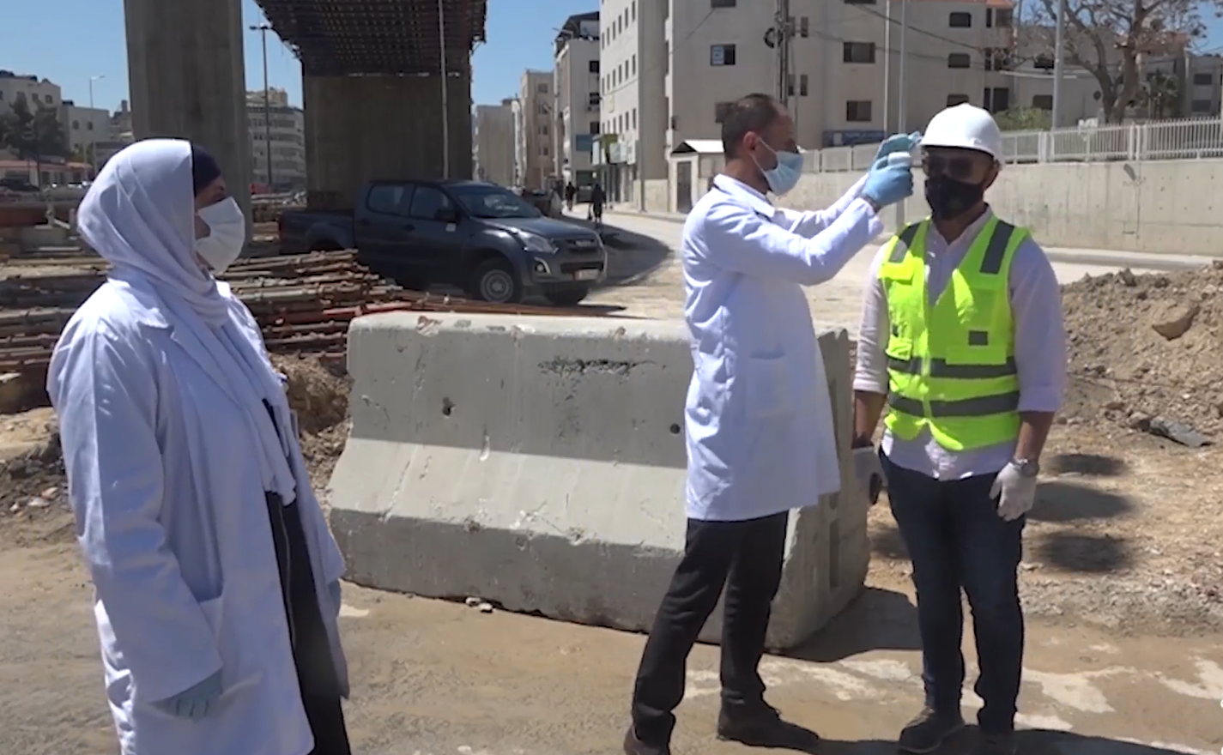
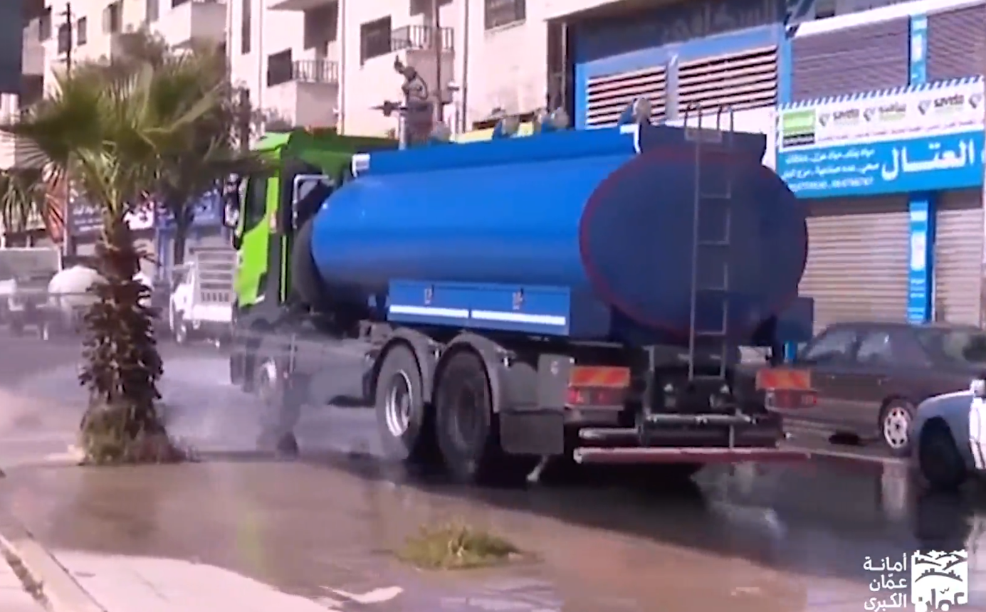
Introduction:
GAM has taken preventive measures to tackle the COVID-19 since the beginning of the Corona crisis within its directorates of regions, departments, and homeland workers in the field:
Notes:
distributed masks and gloves
Created sanitary regulations for slaughterhouses department
installed hand sanitizers in the public buildings
Held a series of awareness-raising workshops to prevent corona virus, and developed an awareness brochure approved by MoH
Approved sterilizers for surfaces and floors in public buildings and specialized sterilizers for slaughterhouse and health and inspection department.

Slide 5
Random testing of the population
For COVID-19
Burial procedures of patients who died due to COVID-19
The concerned authorities have prepared concrete graves in the Sahab cemetery to bury the deceased under special conditions.
Spray the cemetery with special sterilization materials on a daily basis for herbs and materials for health facilities and offices constantly

Slide 6
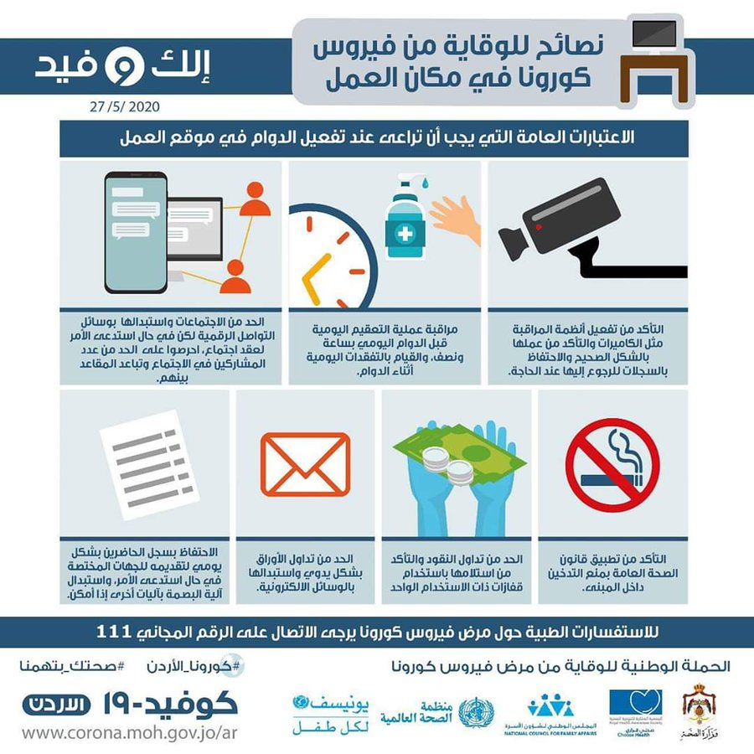
Return to Work
(including Infrastructural Project)
Prepare
General safety procedures manual for the central market of vegetables and fruits to prevent COVID 19
Guidelines booklet for reducing health risks among waste collection workers who deal with human waste or sanitation.
Sterilization and disinfection procedures, waste collection methods and times for collection, and use of personal protective equipment
Guidelines manuals for reducing health risks (in all GAM sectors)

Slide 7
Legal measures against shisha providers (during the past 3 months of the COVID-19 pandemic)
Decision to prevent the delivery of hookahs in cafes and public places, and to take measures not to deliver them to homes. any one violates this decision will expose itself to accountability and the legal procedures followed in this regard.
Also Instructing all shop owners and malls to take precautions to prevent the spread of the Coruna virus. (regularly)

Slide 8
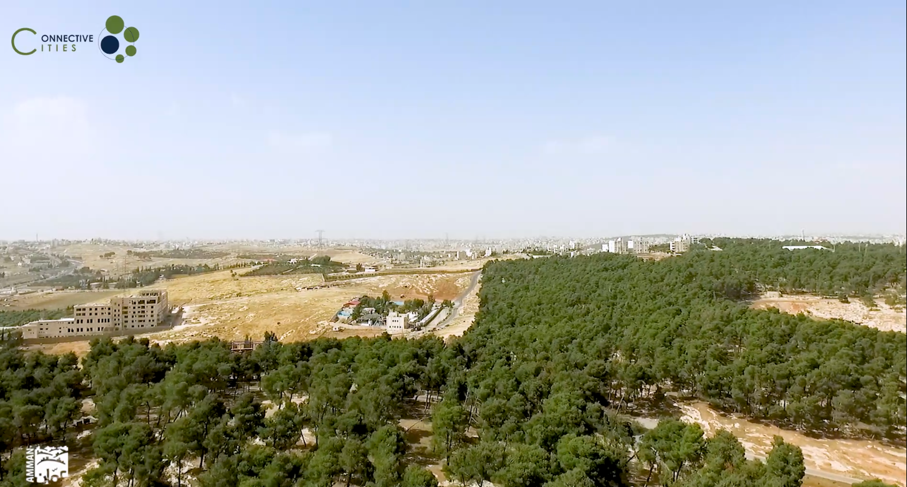
Lessons Learned and resilience planning
الدروس المستفادة والتخطيط للاستدامة والمرونة في العاصمة عمّان

