Slide 1
BANDERY-CHUPRYNKY
WHERE WE ARE NOW?

Slide 2
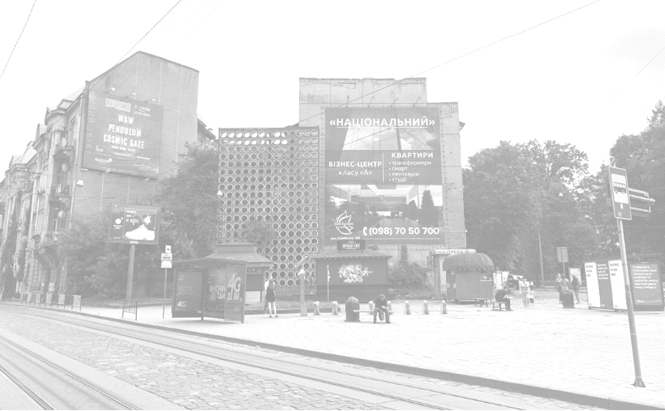
AREA:
ACTIVE AREA
CLOSE TO THE CITY CENTRE
NEXT TO UNIVERSITY BUILDINGS
CULTURAL VENUES NEARBY
IMPORTANT INTERCHANGE ON THE WAY TO THE TRAIN STATION
MEETING POINT
ACTIVE RETAIL AROUND
USERS:
STUDENTS (POLYTECHNIC UNIVERSITY)
PUPILS (3 SCHOOLS NEARBY)
RESIDENTS
TOURISTS (VISITING THIS AREA)
PASSENGERS CHANGING BETWEEN TRANSPORT ROUTES

Slide 3
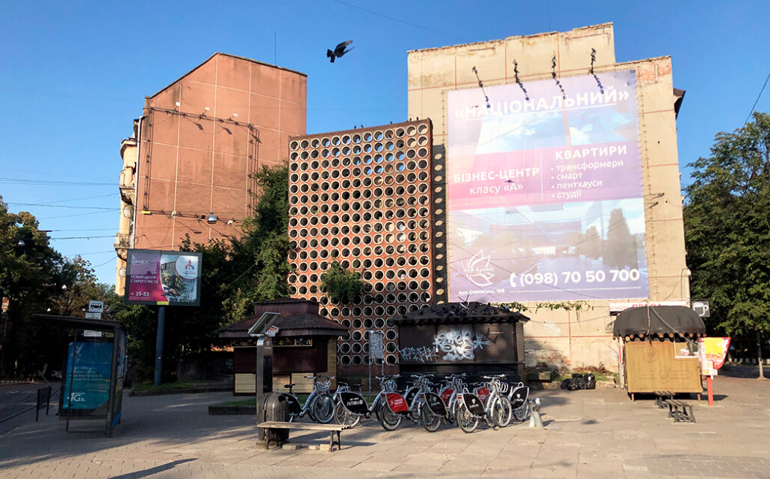
BANDERY - CHUPRYNKY
ALREADY AVAILABLE:
TRAM 1, 2
BUS 9, 42, 15, 41, 24
NEXTBIKE STATION
WALKING DISTANCE TO CITY CENTRE

Slide 4
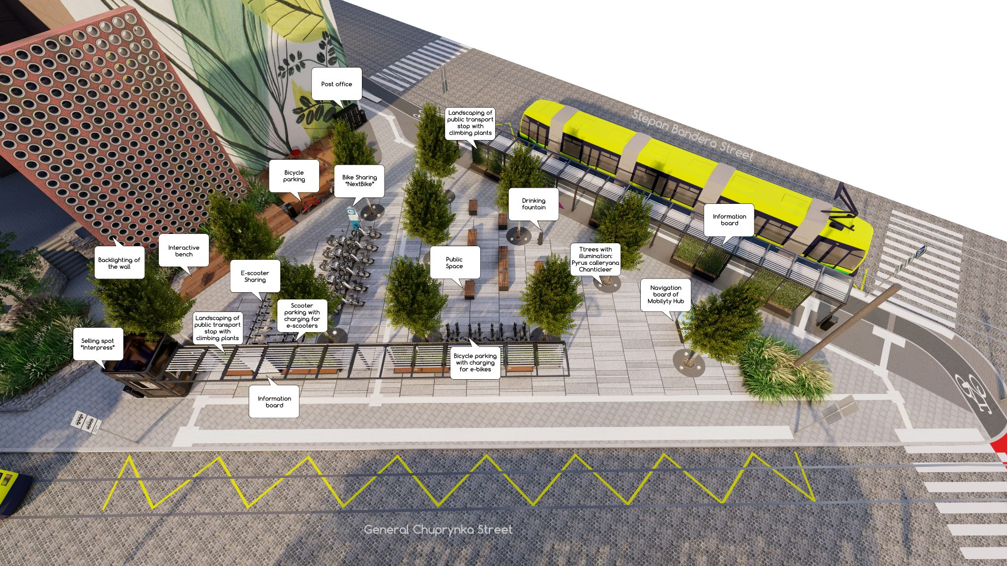
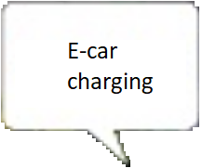
Parcel lockers

Slide 5
TRAMS
BUSES
BIKES
SCOOTERS
CARS
SHARED MOBILITY
Parcel lockers
MOBILITY SERVICES

Slide 6
RETAIL
PUBLIC SPACE
NAVIGATION
POST
Parcel lockers
COMPLEMENTARY SERVICES

Slide 7
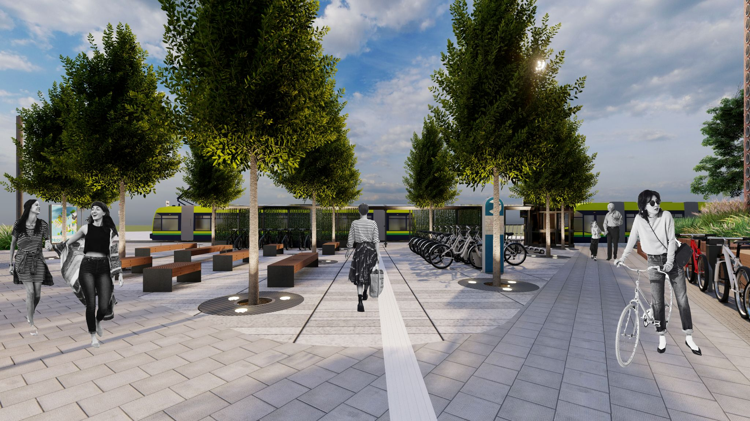
PUBLIC SPACE

Slide 8
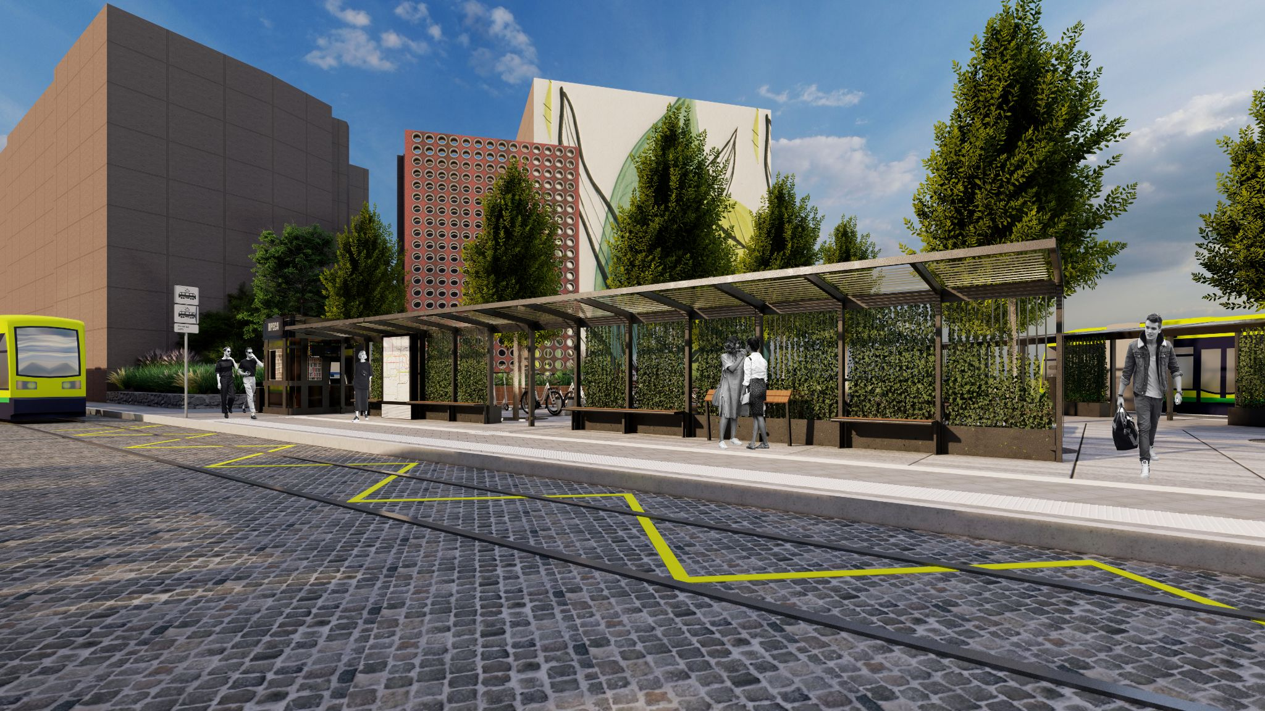
GREENERY FOR CLIMATE MITIGATION

Slide 9
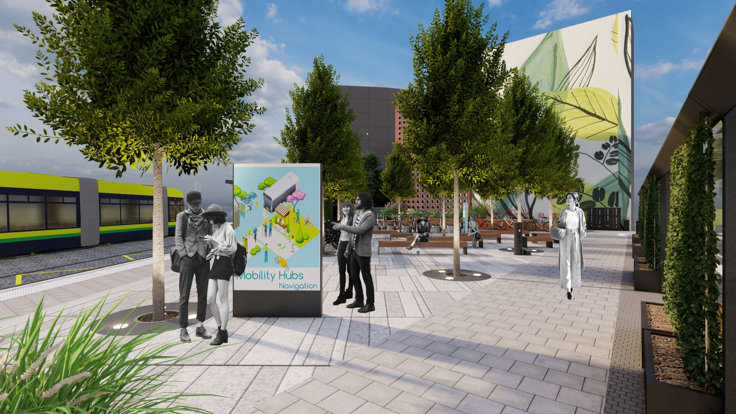
USER-FRIENDLY NAVIGATION

Slide 10
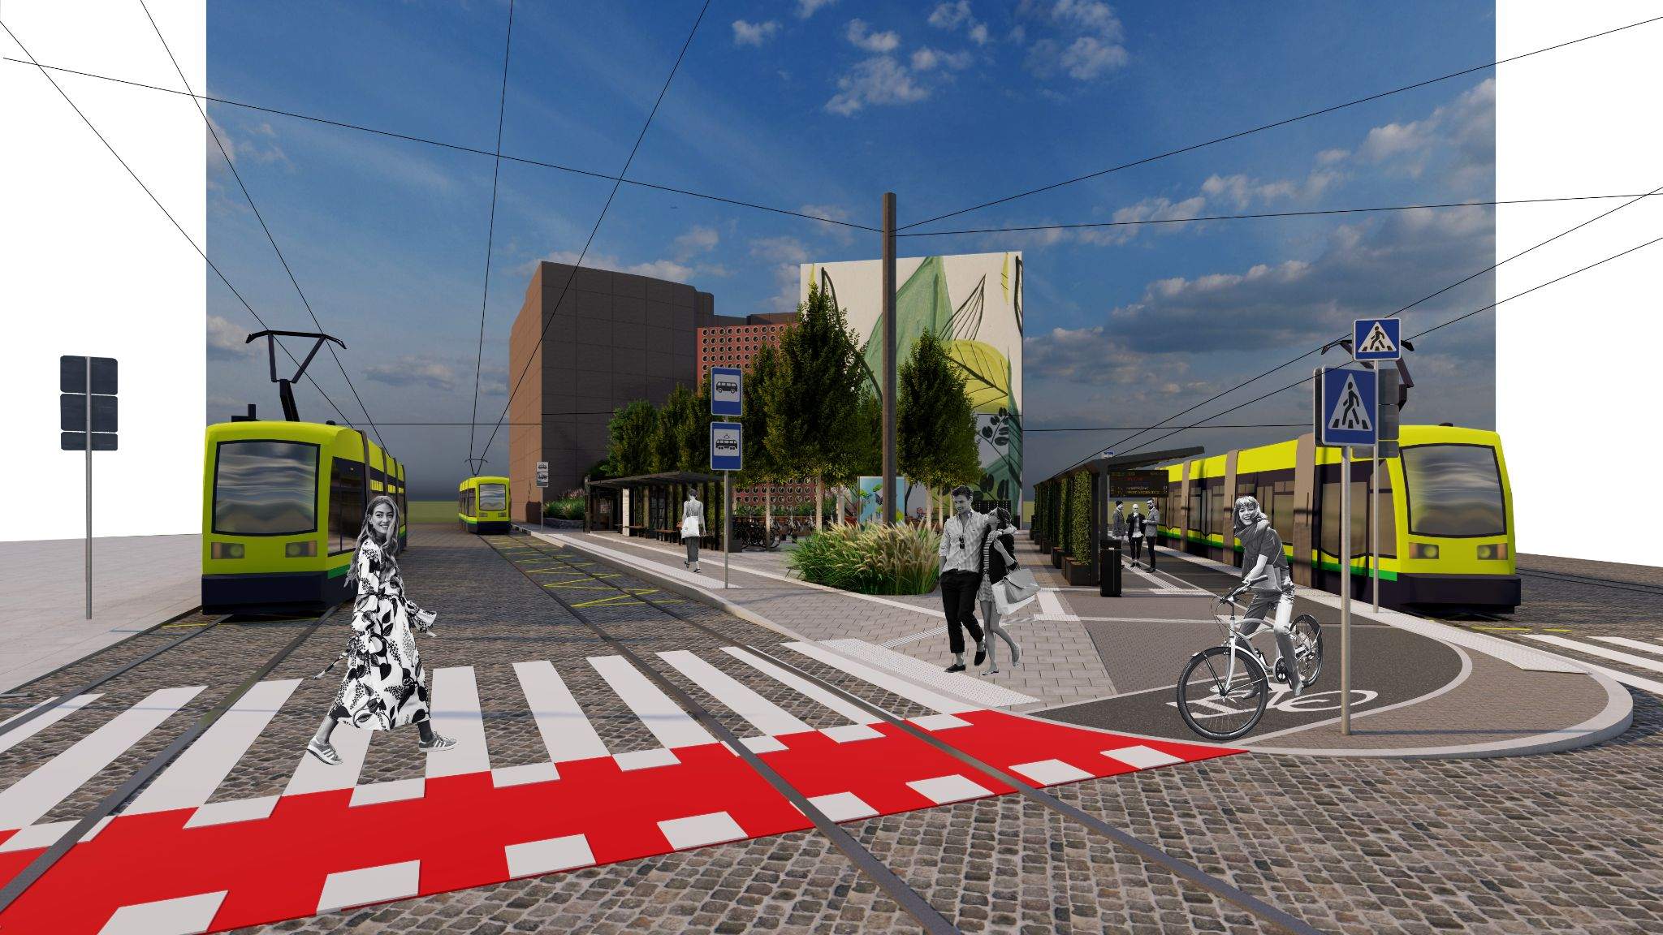
NO-BARRIER CONNECTIVITY

Slide 11
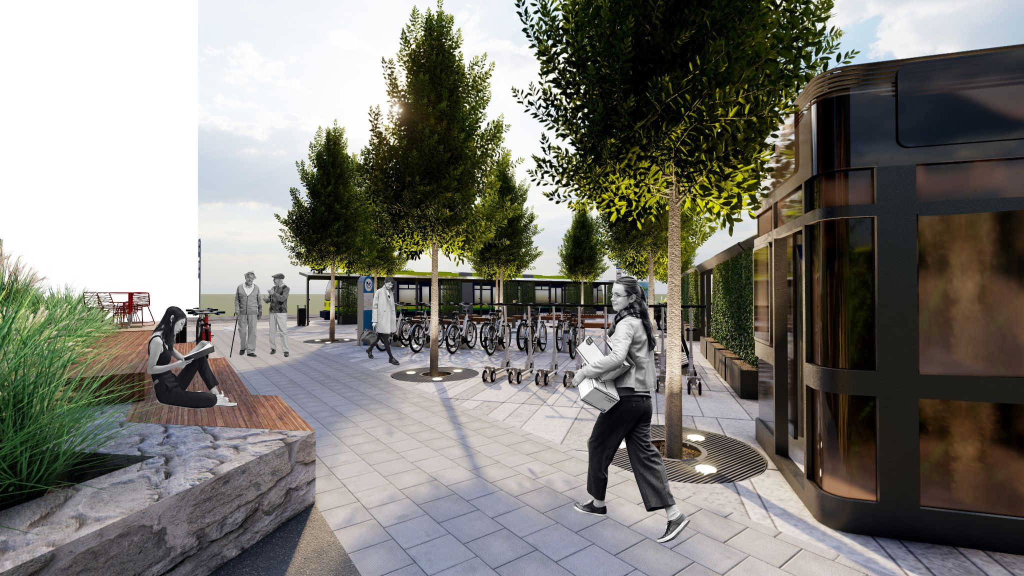
COZY LONGER STAY

Slide 12
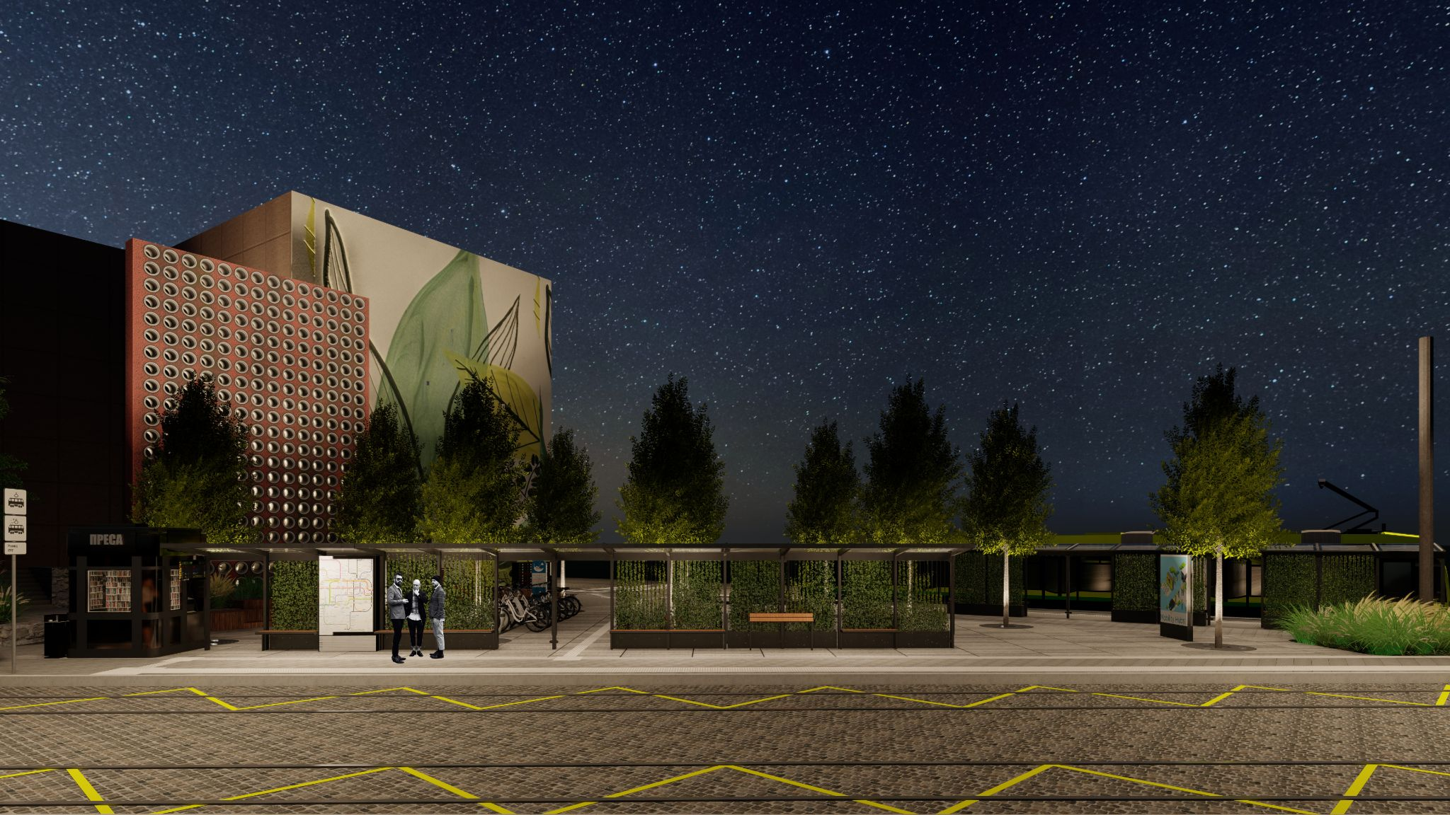
SAFETY 24/7

Slide 13
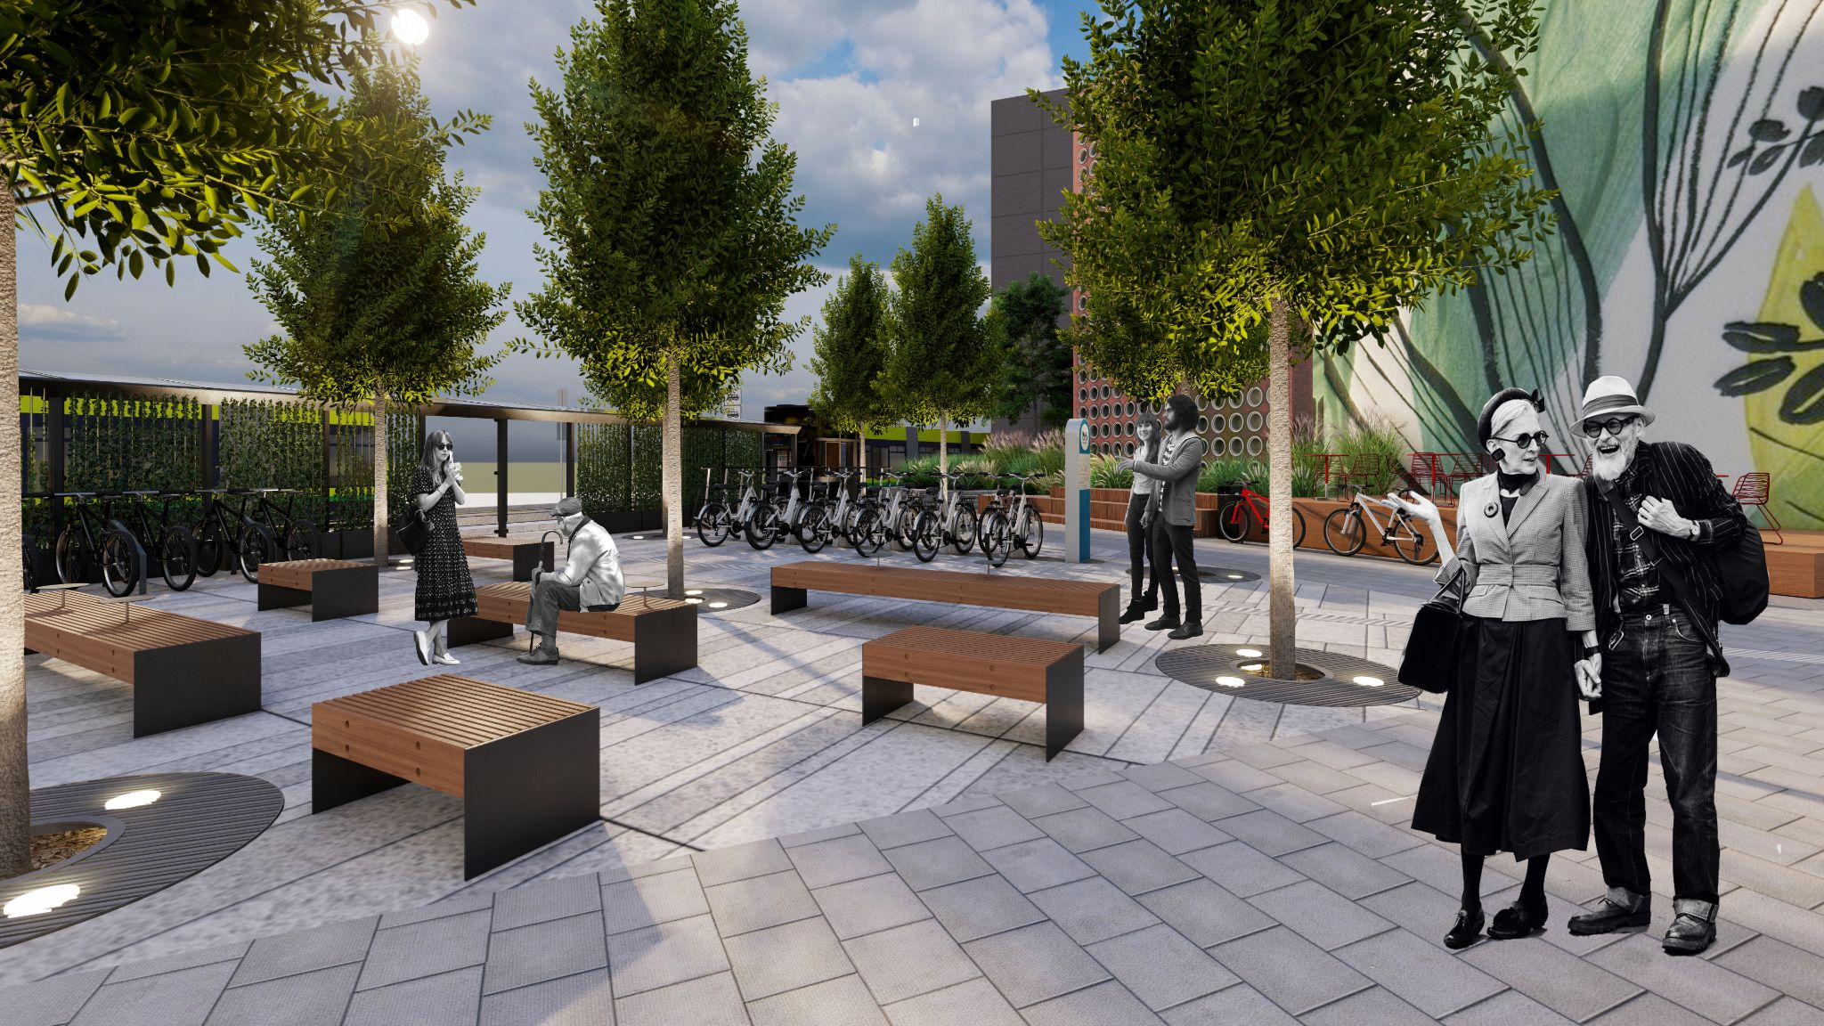
MEET YOU AT BANDERY-CHUPRYNKY:)

